Slide 1
Strategies to Develop Nonprofit Managers to Improve Child Welfare Outcomes in the United States and the Russian Federation
Dr. Alexandra Telitsyna, Senior Research Fellow at the Centre for Studies of Civil Society and Nonprofit Sector and an Associate Professor of Social Sciences School of Politics and Governance, Department of Economics and Management in NGOs, Higher School of Economics, Moscow, Russian Federation
Dr. Kris Sahonchik, Director, Catherine Cutler Institute, Muskie School of Public Service, University of Southern Maine, Portland Maine, United States
ISPCAN Estonia, June 2022
Notes:
Sasha: Senior Research Fellow, HSE
Kris: Direct Research and teach USM
Working together for 8 years improving nonprofit management to improve child welfare outcomes
First through the Eurasia Foundation then through our collaborating universities

Slide 2
Collaboration
Cross Organizational Appointments
Visiting Scholar at the Higher School of Economics
Visiting Fulbright at the University of Southern Maine
Work Included:
Class Development
Teaching
Conference Presentations
Writing
Mutual Goals and Outcomes
Notes:
Kris: I have been a visiting scholar at the higher school of economics
Sasha: A visiting Fulbright
Work: class development, teaching, conference presentations, writing – similar goals: improved management and practice that achieves better outcomes for children, families and communities and improved systems

Slide 3
Child Welfare Management Challenges
How can we improve the way we design, implement and evaluate the work that we do?
How can we shift our focus from collecting data, to using it to improve services for children, families, and communities?
How can we know that practices result in positive child and family outcomes?
How can we hire, manage, retain and promote strong practitioners and leaders?
Notes:
Some of the challenges we are thinking about as former practitioners, educators, and community volunteers and stakeholders

Slide 4
Research that Informs Child Welfare Management
Strategic Management: Poister, Pitts and Edwards
Strategic Planning: Bryson
Getting to Outcomes: Wandersman, et al
Leading Change: Kotter
Implementation: Fixen, et al
Others?
Notes:
Foundational research that has informed our teaching and training; sources appear at the end; review list; you may have your own
Provides and path forward
Birches – theme- common to both of our countries -

Slide 5
Competencies
Leadership and Management
Analyzing, Explaining and Displaying Data
Mapping and Assessing
Macro and Micro Perspectives
Theories of Change
Design, Implementation and Evaluation
Notes:
Foundation:
Leadership and Management: Managing the work, Managing the people and managing yourself
Ability to analyze and explain
Understanding context and relationships and how to frame
Understanding research about change and barriers to change
Creating Frameworks for Design, implementation and evaluation
Going to briefly explore a couple of these topics: Helping folks understand a macro perspective – how to see their work from an aerial view
And helping folks think about implementation – about how they do something is as important as what they do
There is a tendency to look down, not up and outward

Slide 6
Macro Perspectives: Multiple Systems and Partners
The child welfare agencies and non-profits are systems composed of many subsystems (e.g., clinical practice, quality assurance system, training system, human resources, etc.).
Management within the organization (e.g. linking management, supervision and practice; creating integrated policy, planning and training)
Management with other system partners in the larger child welfare community (e.g., social service providers)
Notes:
Try to focus on helping people see connections and relationships both within their organizations and externally
Internally: acquire the ability to see the numerous systems and subsystems and how they need to be aligned – how there is a need to see the interrelationship and interdependence of management supervision and practice AND the codependence of policy, planning and training
Externally: understand the connectedness of other systems and partners

Slide 7
Implementation
Notes:
Use Implementation as an example.
There is often so much time focused on design and little on implementation.
We have made some modification to implementation concepts – Fixen and his colleague's foundational work
Breaking down implementation to understand and address the various stages: first to understand the needs, strengths and challenges; to frame the design; breakdown the implementation and then support the implementation through champions, coaching and leadership; and last using evaluation as a quality assurance tool

Slide 8
Keys to Effective Implementation
Leadership
Stakeholder Involvement
Communication
Culture and Climate
Cross-Functional Project Team
Coaching
Operational Details
Notes:
Spending time helping folks breakdown the different aspects of what will lead to successful implementation of an initiative

Slide 9
Our Approaches
Class discussions utilizing cases and current events
(e.g. local events and Harvard Business School & Kennedy School cases)
Individual projects that develop policies
(e.g. recommendations for policies on pressing issues)
Group projects that develop organizational plans
(e.g. management plans that include need assessment, design, activities, outcomes, and budget)
Notes:
Getting as close to taking apart reality as much as we can -

Slide 10
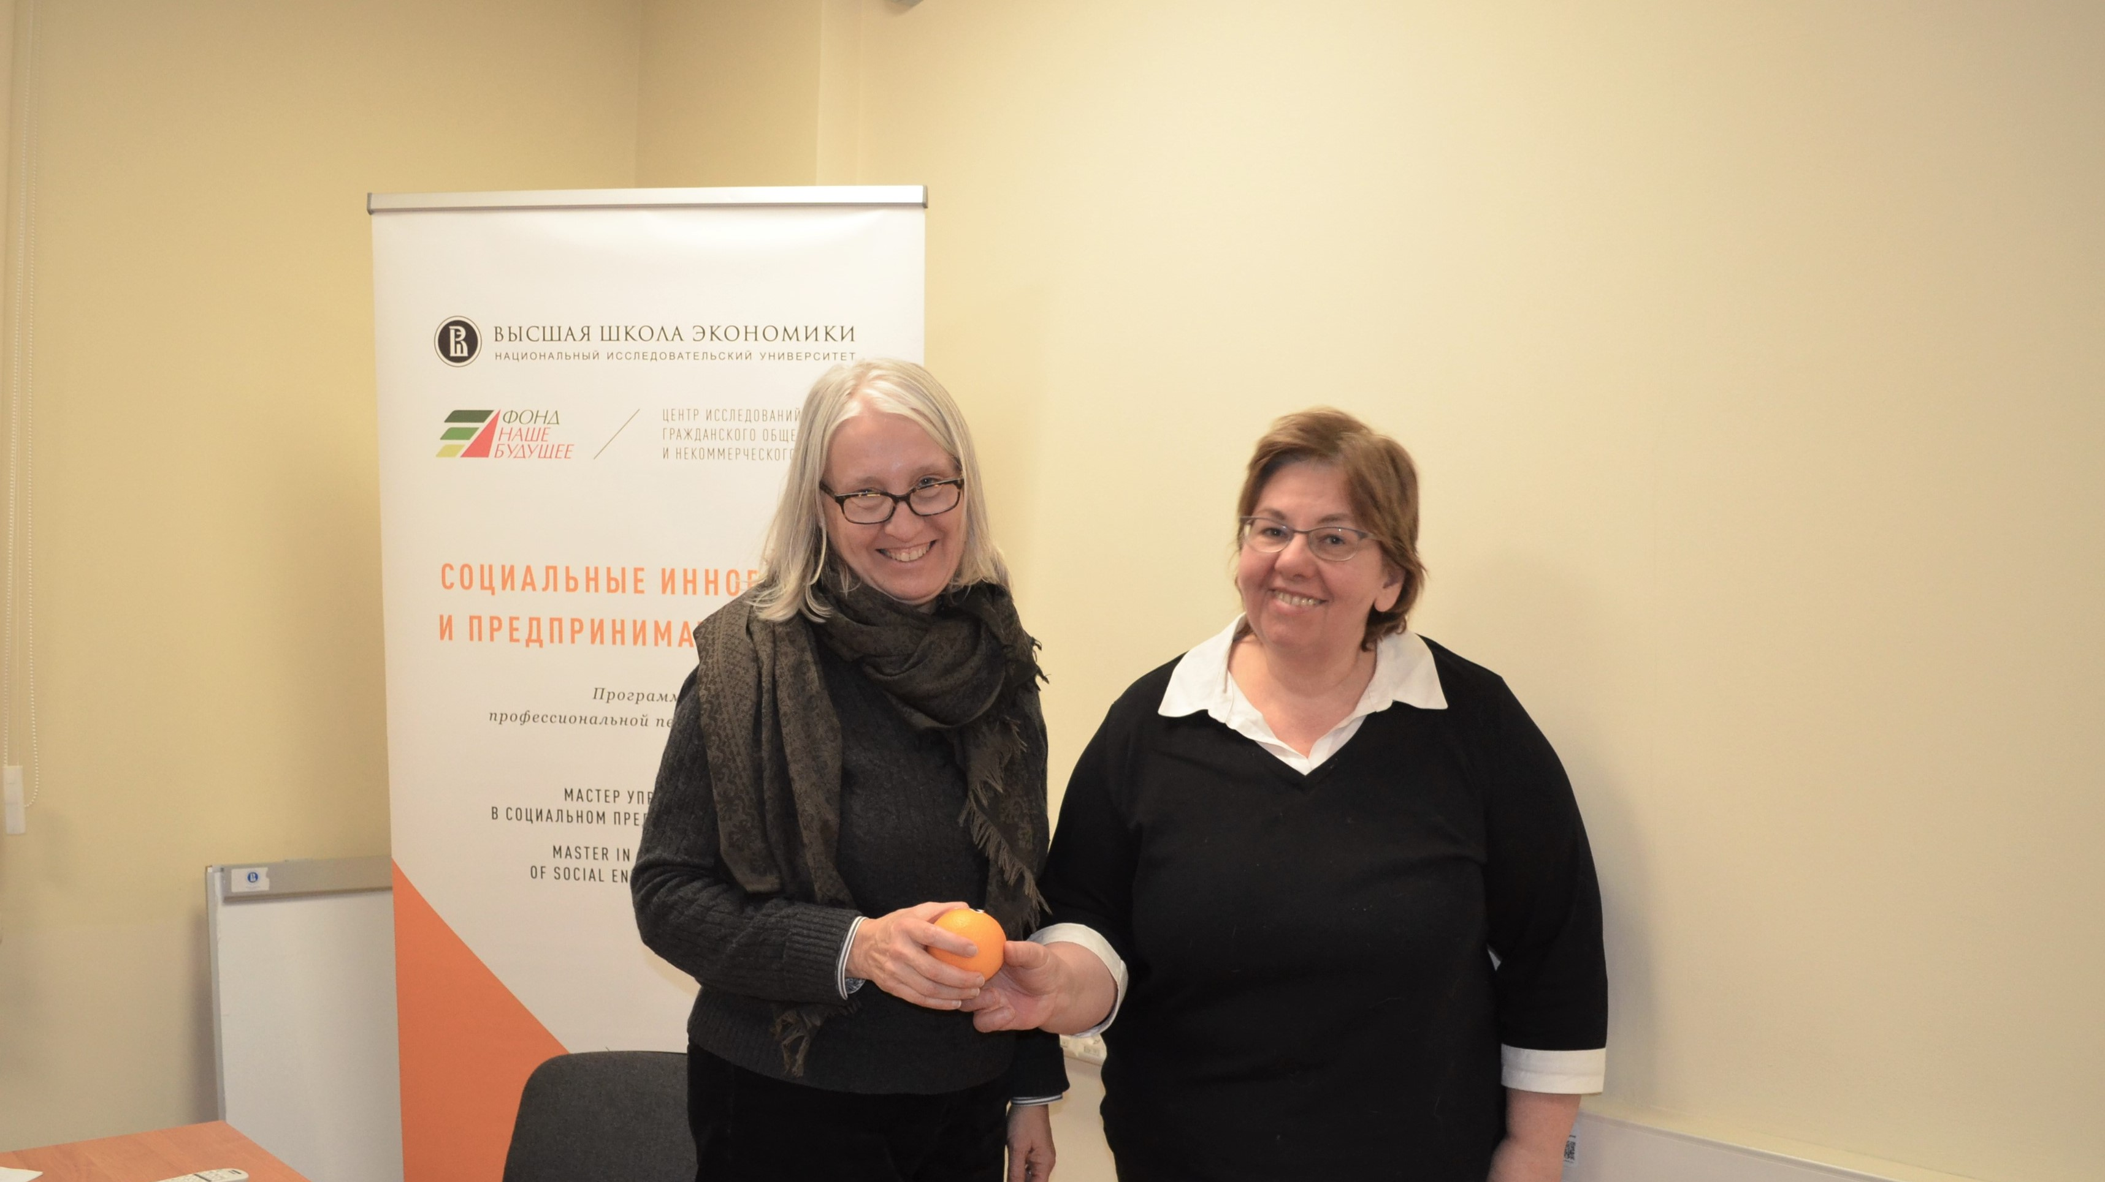

Slide 11
References
Bryson, John M. (1995) (Rev. Ed.) Strategic Planning for Public and Nonprofit Organizations: A Guide
to Strengthening and Sustaining Organizational Achievement. San Francisco, CA: Josse Bass Publishers.
July 2011 4th Edition
Bryson, J. M. (2010). The future of public and nonprofit strategic planning in the United States. Public
Administration Review, 70.
Fixsen, D. L., Naoom, S. F., Blase, K. A., Friedman, R. M. &amp; Wallace, F. (2005). Implementation
Research: A Synthesis of the Literature. Tampa, FL: University of South Florida, Louis de la Parte
Florida Mental Health Institute, The National Implementation Research Network (FMHI Publication
#231)
Bertram, R.M., Blasé, K.A., &amp; Fixsen, D.L. (2015). Improving programs and outcomes: Implementation
frameworks and organizational change. Research on Social Work Practice, 25, 477-487.
Kotter, J. P. (2012). Leading change (2nd Ed.). United States: Harvard Business Review Press.
Poister, T. H., Pitts, D. W., &amp; Edwards, L. H. (2010). Strategic management research in the public sector:
A review, synthesis, and future directions. The American Review of Public Administration, 40(5), 522-
545.
Wandersman, Abraham, Victoria H. Chien, and Jason Katz. Toward an evidence-based system for
innovation support for implementing innovations with quality: tools, training, technical assistance, and
quality assurance/quality improvement. American Journal of Community Psychology 50.3-4 (2012): 445-
459.
Wandersman, A. (2009). “Four keys to success (theory, implementation, evaluation, and resource/system
support0: High hopes and challenges in participation. American Journal of Community Psychology 43:3-
21.
Notes:
References

